Slide 1








T00 PHP + LARAGON
w
bit.ly/fstmtube

Slide 2




3-tier
Tier3 : Database
Tier1 : Client/browser
Tier2 : Middleware (Webserver + PHP)

Slide 3


T1: CLIENT (BROWSER HTML)
The User-interface

Slide 4

T2: Web server + PHP interpreter
Hold logic/ business process
Server-side scripting
Dynamic web

Slide 5

T3: DATABASE
Place to hold database/records/data

Slide 6

LARAGON.ORG
Development stack
https://laragon.org/download.html
Apache/ Nginx / PHP/ MySQL / NodeJS / etc…

Slide 7
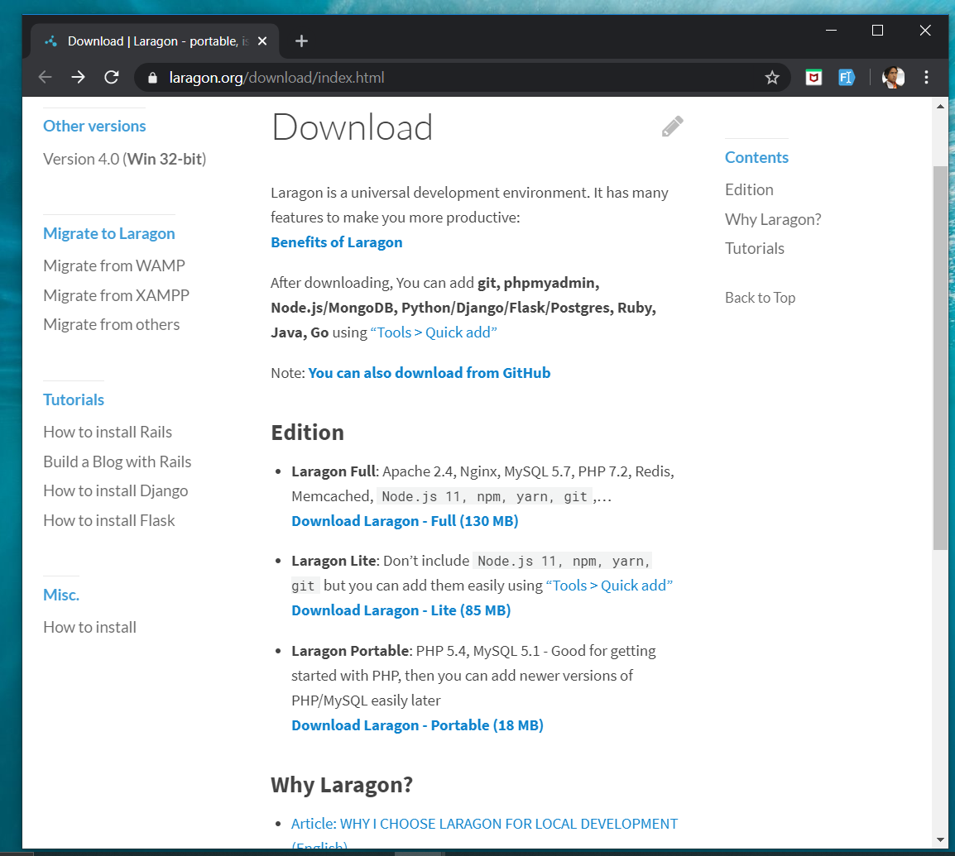
DOWNLOAD FROM LARAGON.org
Laragon.org

Slide 8
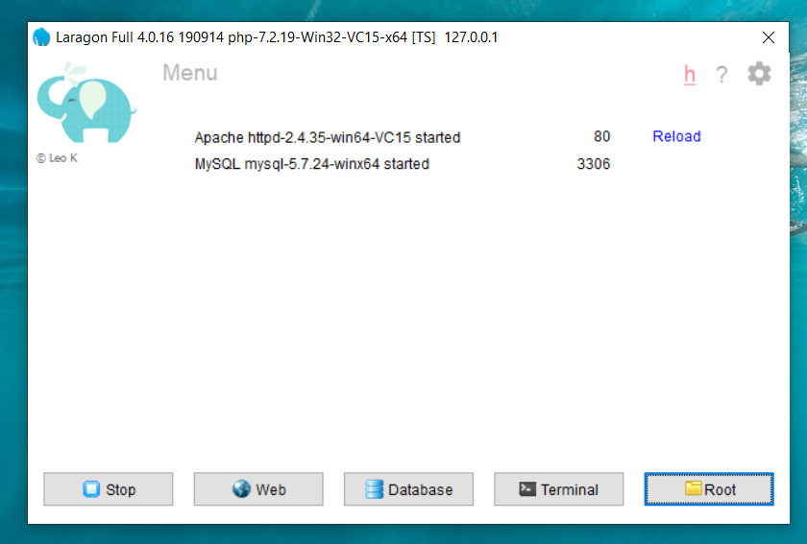
LARAGON INTERFACE
Start/stop servers
localhost
db client (HeidiSQL)
cli/npm/composer
go to webroot folder

Slide 9
T01 HTML5
w
bit.ly/fstmtube

Slide 10
Training outline
HTML5 – refers to the modern day of HTML which promotes native handling of video & audio & animation without having to install additional plugins to browser.
Bootstrap – A HTML framework supports responsive web design to provide one time webpage development for smartphone, tablet and desktop.

Slide 11
HTML5
HTML5 – refers to the modern day of HTML which promotes native handling of video & audio & animation without having to install additional plugins to browser.
<!DOCTYPE html>
Try: https://www.w3schools.com/html/tryit.asp?filename=tryhtml_headings

Slide 12
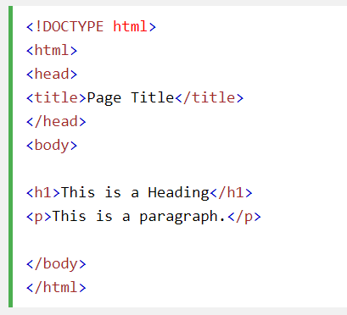
Typical HTML CODE

Slide 13
HTML5 image handling
<img src="pic_mountain.jpg" alt="Mountain View" style="width:304px;height:228px;">
Use width 100% to support responsive layout design.
Try: https://www.w3schools.com/html/tryit.asp?filename=tryhtml_images_trulli

Slide 14
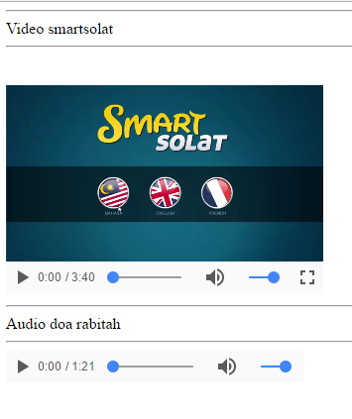
HTML5 Native video
<video width="320" height="240" controls> <source src="movie.mp4" type="video/mp4"> <source src="movie.ogg" type="video/ogg"> Your browser does not support the video tag. </video>
Try: https://www.w3schools.com/html/tryit.asp?filename=tryhtml5_video

Slide 15
HTML5 Native AUDIO
<audio controls> <source src="horse.ogg" type="audio/ogg"> <source src="horse.mp3" type="audio/mpeg"> Your browser does not support the audio element. </audio>

Slide 16
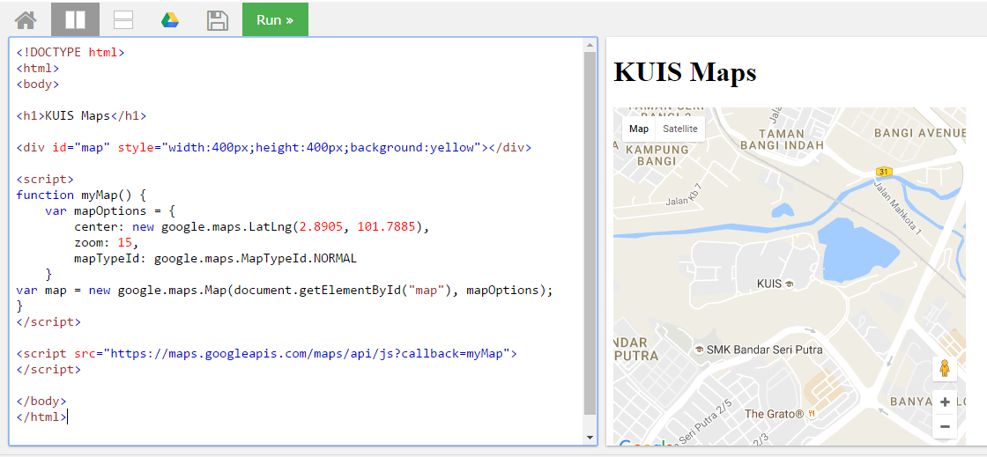
Location MAPS

Slide 17
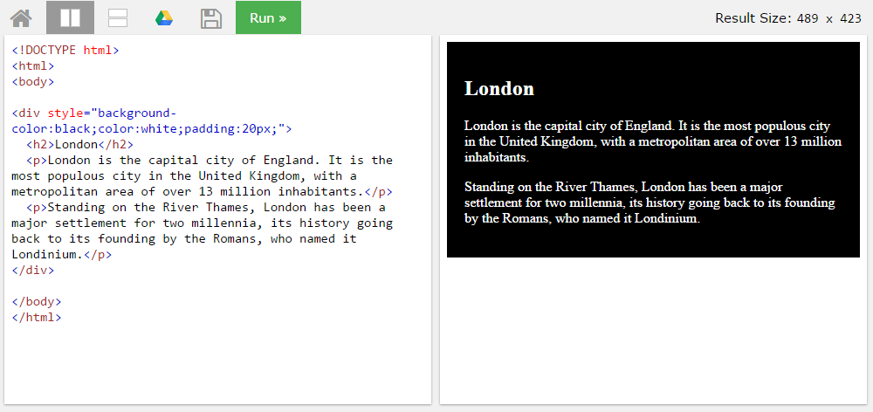
BLOCK <DIV>

Slide 18
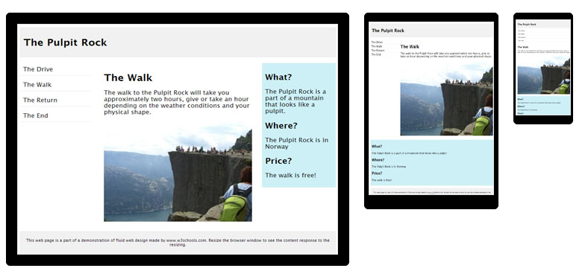
HTML Responsive layout

Slide 19
HTML Responsive layout
What is Responsive Web Design?
Responsive Web Design makes your web page look good on all devices (desktops, tablets, and phones).
Responsive Web Design is about using CSS and HTML to resize, hide, shrink, enlarge, or move the content to make it look good on any screen

Slide 20
VIEWPORT
<meta name="viewport" content="width=device-width, initial-scale=1">
The viewport varies with the device, and will be smaller on a mobile phone than on a computer screen.
The initial-scale=1.0 part sets the initial zoom level when the page is first loaded by the browser.

Slide 21
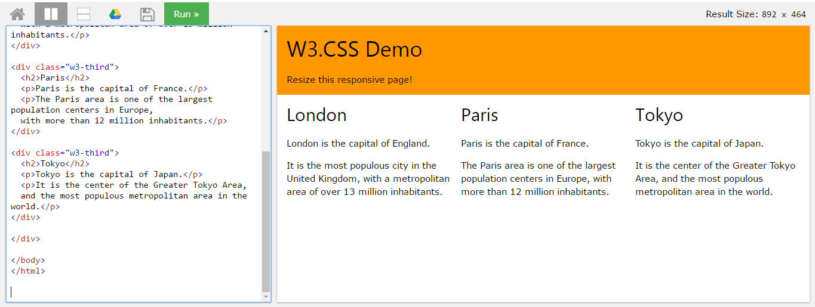
HTML Responsive layout

Slide 22
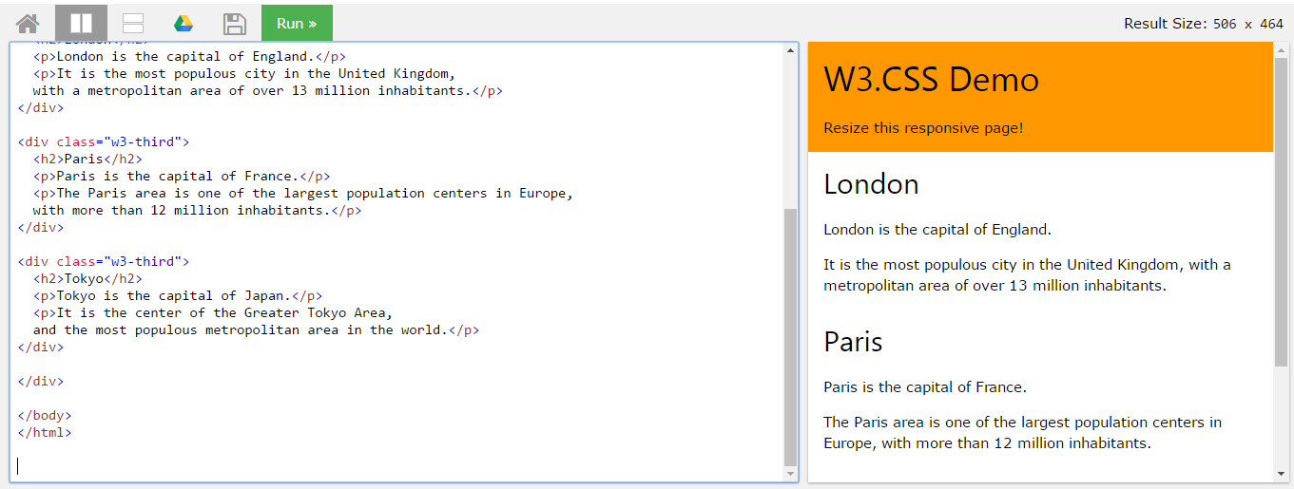
HTML Responsive layout

Slide 23
T02 BOOTSTRAP + PHP include
w
bit.ly/fstmtube

Slide 24

Bootstrap
A HTML framework supports responsive web design to provide one time webpage development for smartphone, tablet and desktop.

Slide 25
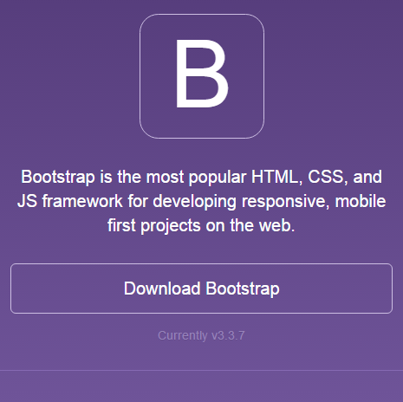
Bootstrap
Download framework from getbootstrap.com
OR use the CDN

Slide 26
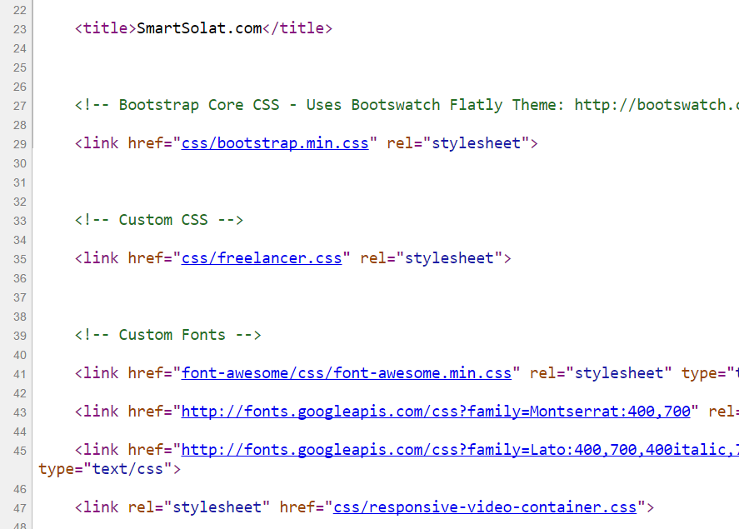
Bootstrap -setting
Copy the CSS script to the project folder.
> OR we can use CDN server

Slide 27
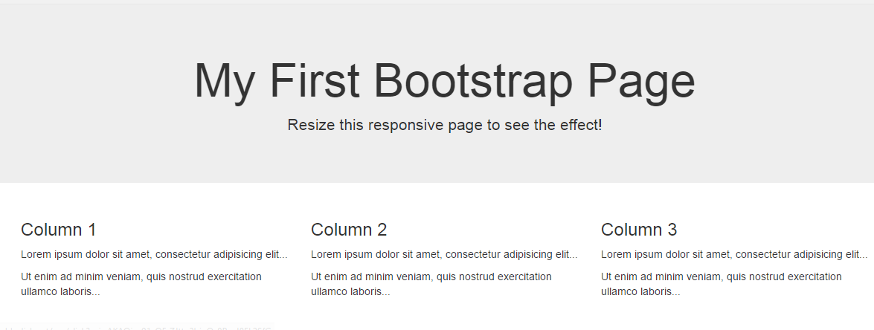
Basic bootstrap layout
Try it here http://www.w3schools.com/bootstrap/tryit.asp?filename=trybs_default&stacked=h

Slide 28
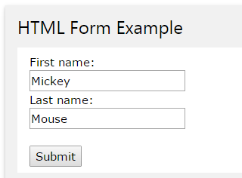
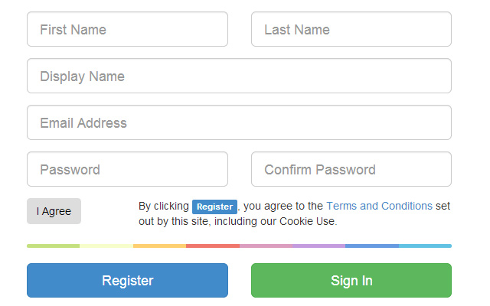
BOOTSTRAP FORM

Slide 29
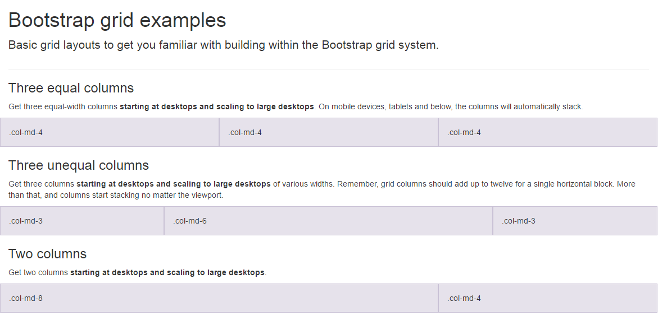
BootSTRAP GRID SYSTEM

Slide 30
BootSTRAP GRID SYSTEM DESKTOP
Banner
Main Content
Sidebar
Footer

Slide 31
BootSTRAP GRID SYSTEM MOBILE
Banner
Main Content
Sidebar
Footer

Slide 32
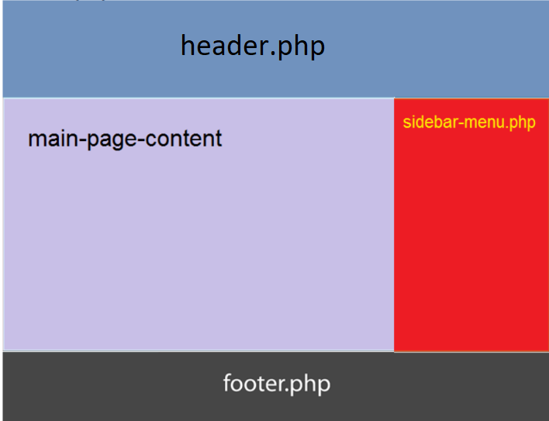
Include php
include (“header.php”);
<our content>
include (“footer.php”);

Slide 33

FREE STARTbootstrap.com
Example https://startbootstrap.com/

Slide 34
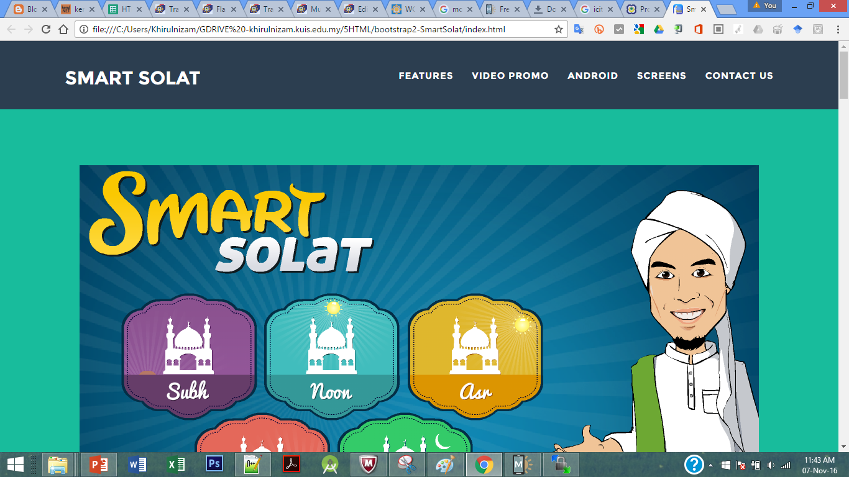
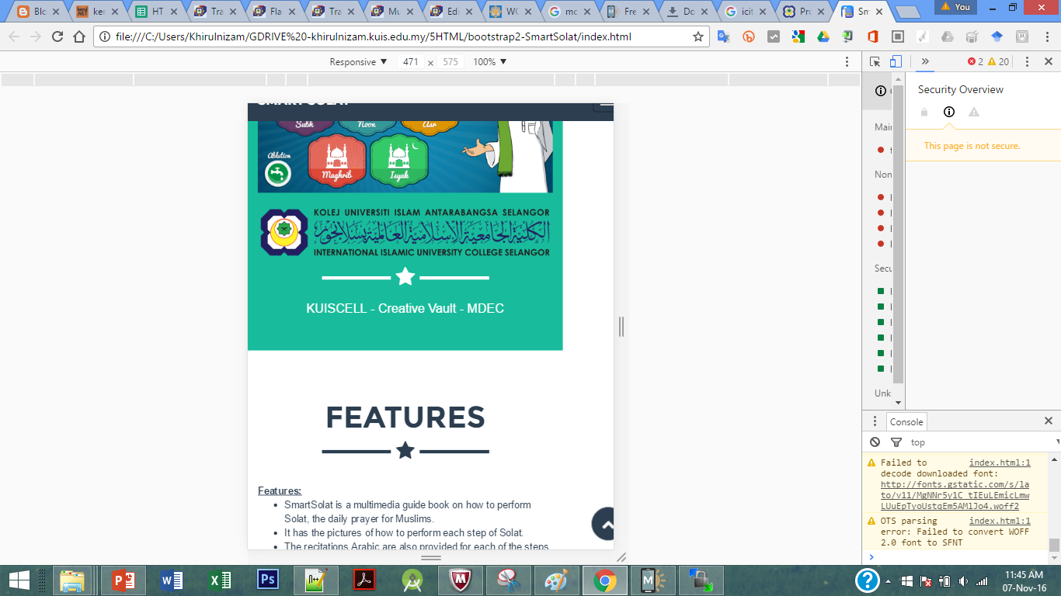
Sample2 - smartsolat

Slide 35
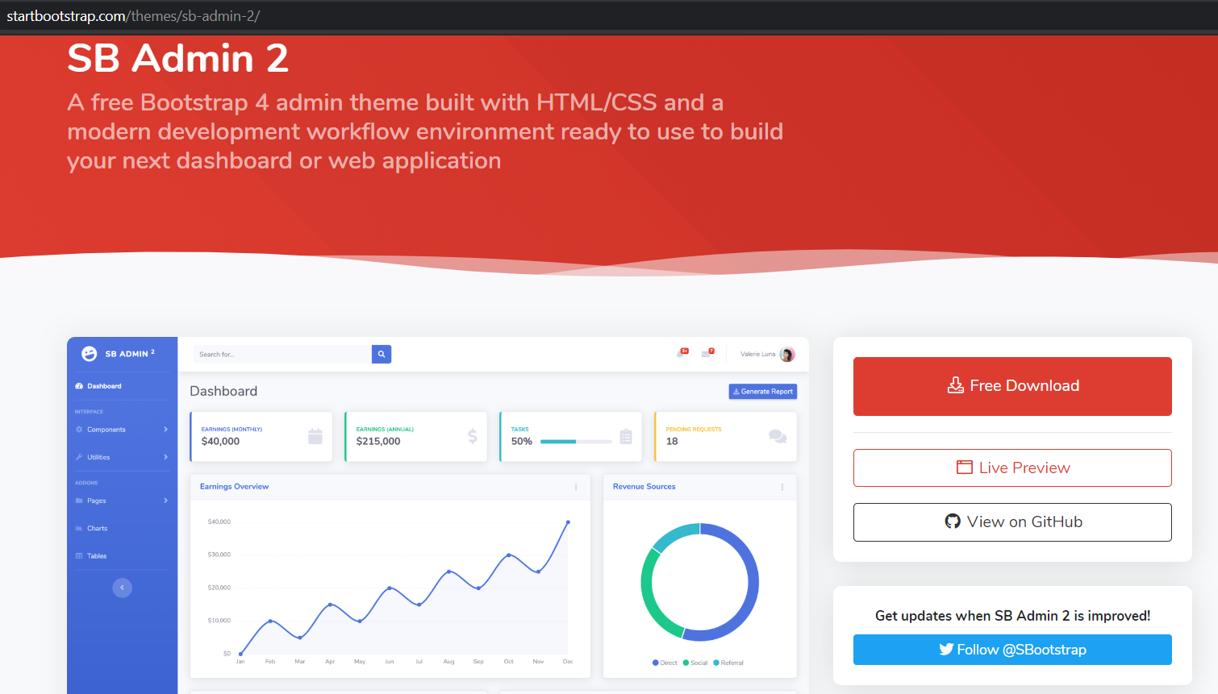
startbootstrap.com/themes/sb-admin-2/

Slide 36
T03: PHP SYNTAX & ECHO
w
bit.ly/fstmtube

Slide 37

Introduction
What is Web programming:
Combination of server-side and client-side to develop a dynamic website.
The application is deployed in the Web environment and can be access by multiple concurrent users.

Slide 38
Introduction to PHP
PHP= PHP: Hypertext Preprocessor:
Is a server-side scripting language.
PHP scripts are executed on the server, and the output from the process is inserted to the Web page as a part of the content before transmitted to the browser.
The script will not be sent to the browser which request the Web page, so the script is not visible to the users.

Slide 39
Introduction to PHP
Server-side Scripting | Client-side scripting
The script embedded inside the HTML page, interpreted and executed inside the server (the web server) and the result/output of the execution is sent to the browser. The script interpreted and executed inside the server. E.g.: PHP, ASP. | The script embedded inside the HTML page, downloaded with the HTML page and executed on the client (browser). E.g.: JavaScript.

Slide 40
Introduction to PHP
Why PHP?
Runs on different platforms (Windows, Linux, Unix, etc.).
Is compatible with almost all servers used today (Apache, IIS, etc.).
Is free to download.
Is easier to learn and runs efficiently on the server side.

Slide 41
PHP Script Tag
A PHP scripting block always starts with <?php and ends with ?>
A PHP scripting block can be placed anywhere in the document.
On servers with shorthand support enabled ( enable in php.ini) may start a scripting block with <? and end with ?>

Slide 42
PHP Script Tag
A PHP file normally contains HTML tags, just like an HTML file, and some PHP scripting code.
Next, we have an example of a simple PHP script which sends the text “Assalamualaikum" to the browser:

Slide 43
PHP Script Tag
<html>
<head>
<title> Web Programming </title>
</head>
<body>
<?php
echo "Assalamualaikum";
?>
</body>
</html>

Slide 44
PHP Script TAG
Each code line in PHP must end with a semicolon ( ; ).
The semicolon is a separator and is used to distinguish one set of instructions from another.

Slide 45
PHP Script Tag
There are two basic statements to output text with PHP: echo and print.
In the example before, we have used the echo statement to output the text "Assalamualaikum".

Slide 46
PHP ECHO
<?php
$txt="Assalamualaikum!";
$x=23;
echo "Assalamualaikum!";
echo $x;
?>

Slide 48
T04 SYNTAX PHP COMMENTS & VARIABLE
w
bit.ly/fstmtube

Slide 49
Comments in PHP
Comment is remark inside code that will not be compiled (ignored when the program is compiled).
It will not effect the code.
It is a good practice to write the comment.
Comment is useful the tell others what is the program is doing.
Helps programmer to memorize what is he doing.

Slide 50
Comments in PHP
In PHP, we use:
// to make a single-line comment or
/* … */ to make a large comment block.

Slide 51
Comments in PHP
<html>
<head>
<title> Web Programming </title>
</head>
<body>
<?php //This is a comment /* This is a comment block */ ?>
</body>
</html>

Slide 52
T05 SYNTAX PHP VARIABLES & CONCAT
w
bit.ly/fstmtube

Slide 53
PHP Variables
Variables are used for storing values, like text strings, numbers or arrays.
When a variable is declared, it can be used over and over again in your script.
All variables in PHP start with a $ sign symbol.
The correct way of declaring a variable in PHP:
Eg: $var_name = "Kerul";

Slide 54
PHP Variables (cont)
New PHP programmers often forget the
$
sign at the beginning of the variable.
In that case it will not work.
Let's try creating a variable containing a string and a variable containing a number:

Slide 55
PHP Variables (cont)
<?php
$txt="Assalamualaikum!";
$x=23;
echo $txt;
?>

Slide 56
EXAMPLE ON VARIABLE
Write the echo( )statement to display the following message:
Assalamualaikum!23

Slide 57
Naming Rules for Variables
A variable name must start with a $
A variable name can only contain alpha-numeric characters and underscores (a-z, A-Z, 0-9, and _ ).
A variable name should contain no space.
If a variable name is more than one word, it should be separated with an underscore ($my_string), or with capitalization ($myString).

Slide 58
EXAMPLE
Decide whether the following variables are valid or invalid. Give your reason.
$apa 11) $my_books
$123lekuk 12) $_myFamily
$what-is-the-number 13) $my address
$_uji1 14) $my2numbers
$my name
$For
IF
$float
$variable_to_hold_names_or_matrix_for_students
$hasil*nombor

Slide 59
Lateral Values
Lateral is the exact/actual value.
The value could be number (integer or real), character, string, or Boolean.

Slide 60
Lateral Values (cont)
Integer:
Integer is round number.
For example, 10 is an integer.
E.g.:
$num = 10;
$num = -10;
Use negative sign for negative numbers.

Slide 61
Lateral Values (cont)
Float:
E.g.:
$temp = 21.1225;
$product = 0.0;

Slide 62
Lateral Values (cont)
Characters:
To assign a character value into a char variable, the value must be put inside a open and close single or double quote.
E.g.:
$nama = 'Encik';
$name = "Kerul";

Slide 63
Lateral Values (cont)
Boolean:
There are only two values for Boolean variable: true and false.
E.g.:
$eatalready = true;
$isInteger = false;

Slide 64
Lateral Values (cont)
String:
A group of characters.
Marked with single or double quote.
E.g.:
$stmt = "How are you";

Slide 65
Concatenation Operator
There is only one string operator in PHP.
The concatenation operator ( . ) is used to put two string values together.
To concatenate two string variables together, use the concatenation operator:

Slide 66
Concatenation (cont)
<?php $txt1="Assalamualaikum!"; $txt2="Have a nice day!";
echo $txt1 . " " . $txt2; ?>

Slide 67
Concatenation (cont)
The simpler way in doing concatenation:
<?php $txt1="Assalamualaikum!"; $txt2="Have a nice day!";
echo "$txt1 $txt2"; ?>

Slide 68
Concatenation (cont)
Or, if you want to print the output in a separate line:
<?php $txt1="Assalamualaikum!"; $txt2="Have a nice day!";
echo "$txt1 <br> $txt2"; ?>

Slide 69
Concatenation (cont)
Array:
<?php $num[0]=3;
echo "Number ".$num[0];
echo "Number $num[0] ";//not possible
?>

Slide 70

T05+1 INPUT PROCESS OUTPUT
bit.ly/fstmtube

Slide 71
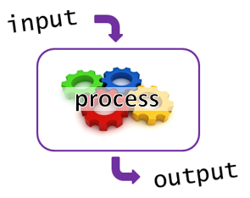
I-P-O
Input data
Process the data by converting into information
Output – convey the information as something meaningful

Slide 72
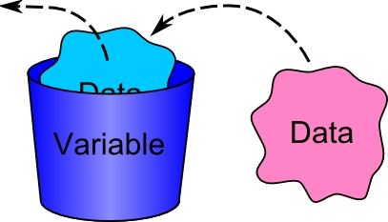
PHP Variables
Variables are used for storing values, like text strings, numbers or arrays.
All variables in PHP start with a $ sign symbol.
The correct way of declaring a variable in PHP:
Eg: $num1= 3; $num2=5;

Slide 73
Naming Rules for Variables
A variable name must start with a $
A variable name can only contain alpha-numeric characters and underscores (a-z, A-Z, 0-9, and _ ).
A variable name should contain no space.
If a variable name is more than one word, it should be separated with an underscore ($my_string), or with capitalization ($myString).

Slide 74
Arithmetic Operations
Operator | Operation | Example
 |  | Mathematical expression | PHP expression
+ | Addition | num1 + 3 | $total=$n1 + $n2;
- | Subtraction | pi - y | $q=$pi - $y;
* | Multiplication | width x height | $area=$width * $height;
/ | Division | a/b | $div=$a/$b;
% | Modulus | num modulo 2 | $even=$nom%3;

Slide 75
PROCESS: ADD 2 NUMBERS
Input process output
$num2 3
$num1 5
$total 8

Slide 76
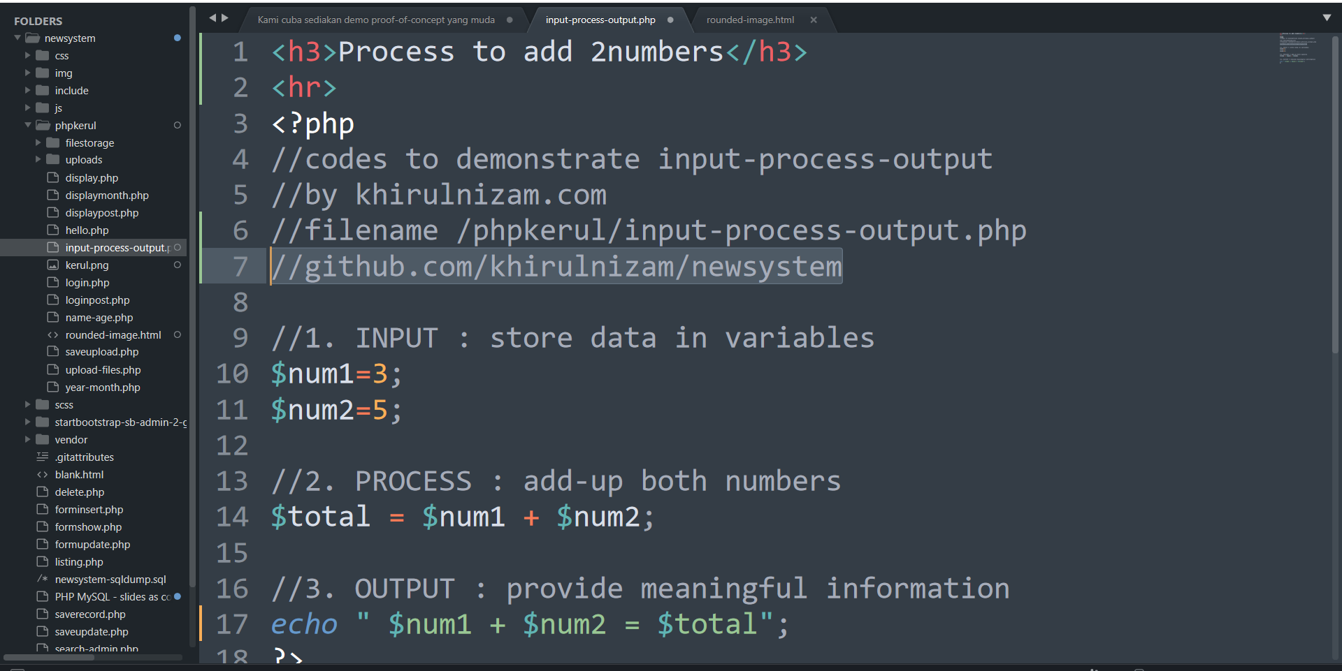
github.com/khirulnizam/newsystem

Slide 77
T06 FORM INPUT
w
bit.ly/fstmtube

Slide 78
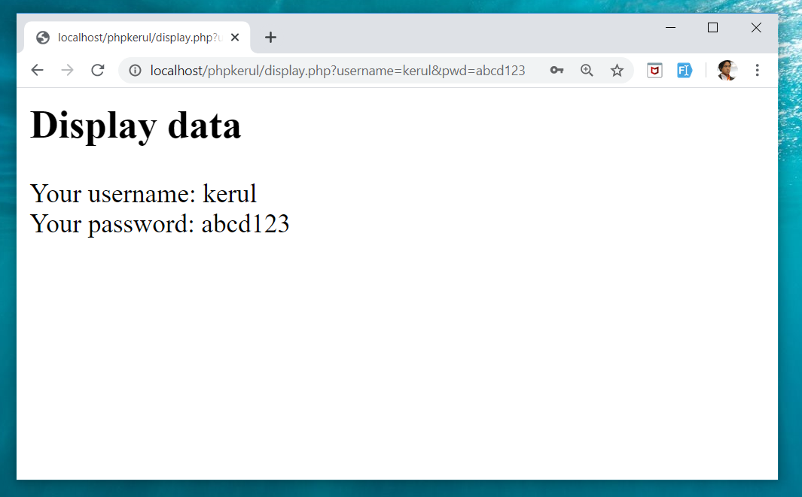
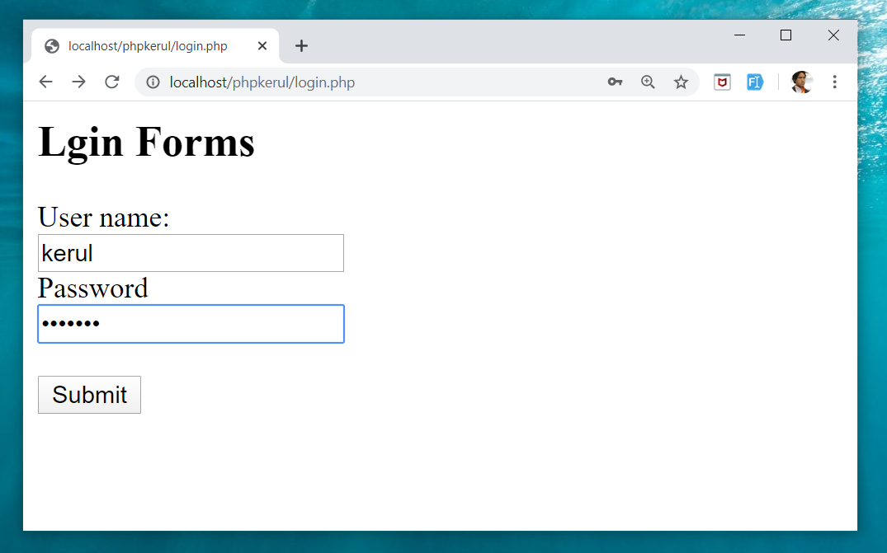
Example (cont)

Slide 79
Input Through HTML
<form name=“aform” method=“GET” action=“save.php”>
input…
</form>
This is the typical structure of form:
name: is the name of the form.
method: how the data is transferred (POST or GET).
action: is the target file resides in the Web server that receive the data from the form.
input: are the input elements (text field, checkbox, radio button, etc.).

Slide 80
GET vs. POST
GET | POST
Is basically for just getting (retrieving) data. The variable name and the value appear and visible in the URL. Form data is to be encoded (by a browser) into at the end of the URL of the target file. | Form data is embedded within a message body. POST may involve anything, like storing files to the server, updating data, ordering a product, or sending an e-mail. The variable name and the value do not appear in the URL.

Slide 81
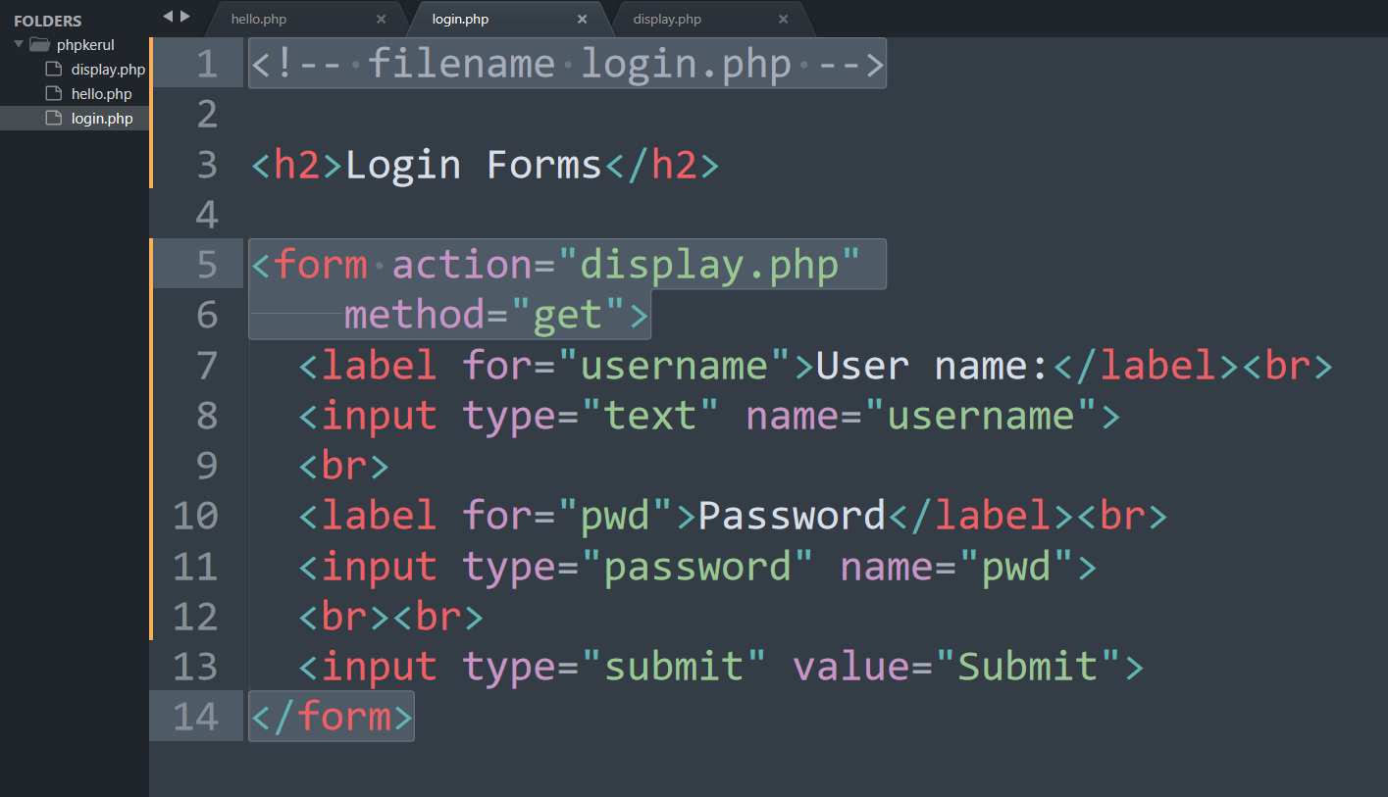
Example (Using GET Method)

Slide 82
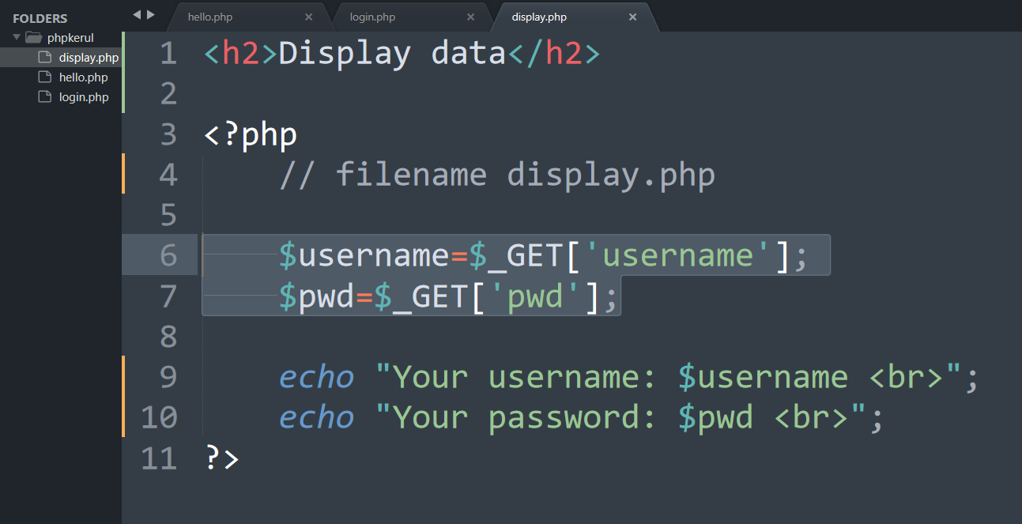
Display.php

Slide 83
Example (cont)

Slide 84
Example (Using POST Method)

Slide 85
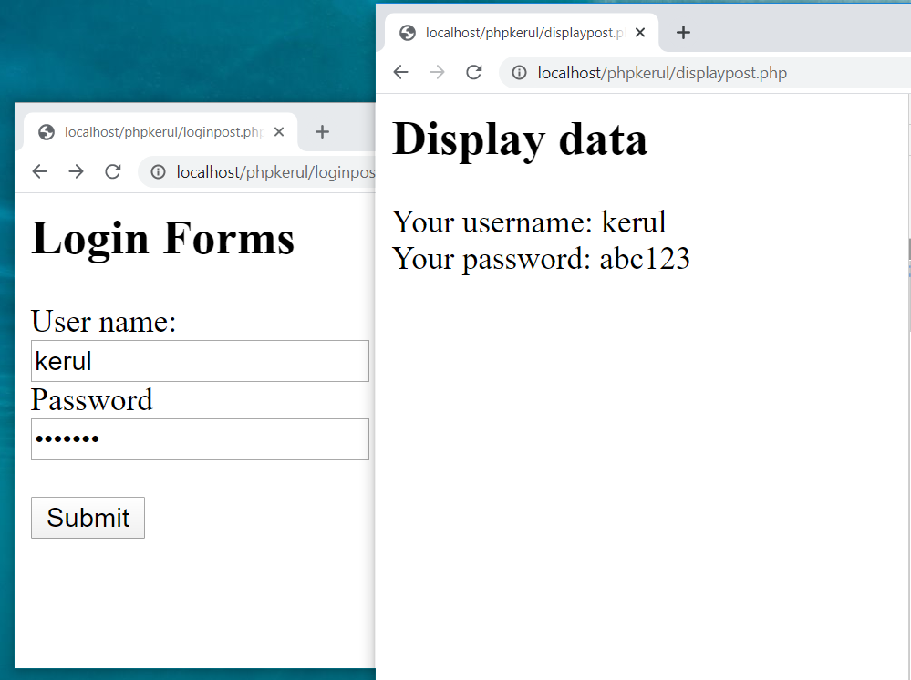

Slide 86
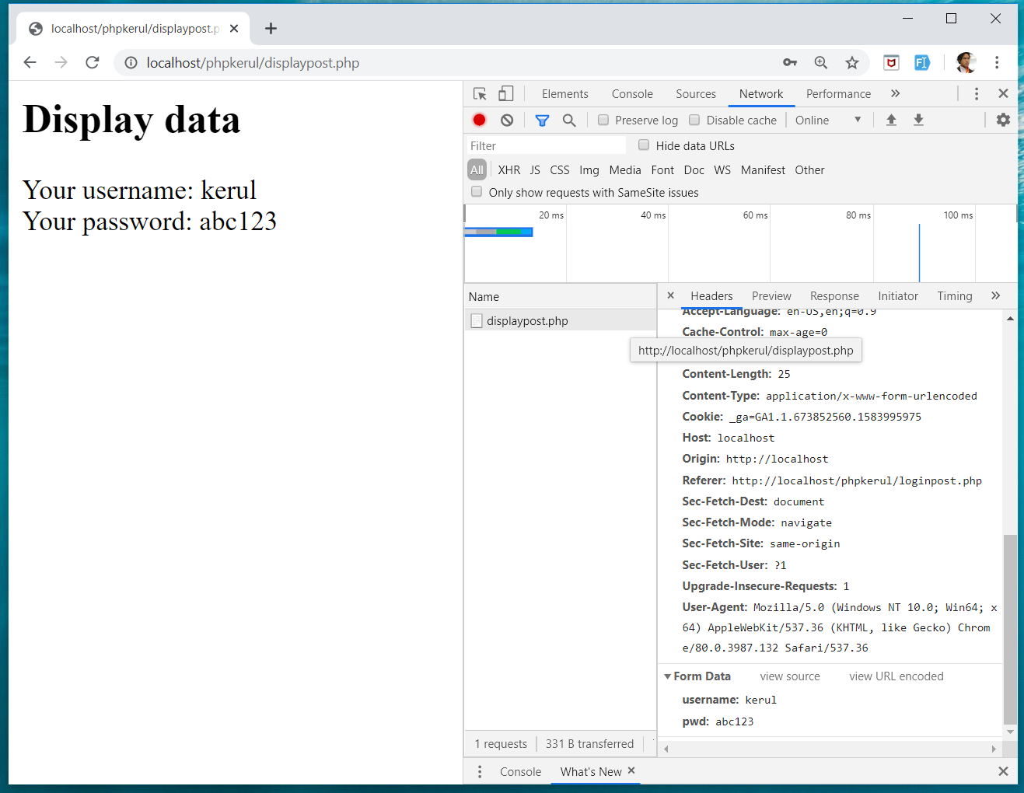
INSPECT TOOLS
F12

Slide 87
T07 SELECTION (PILIHAN) IF…Else
w
bit.ly/fstmtube

Slide 88
Comparison Operators
Operator | Meaning | Example
== | Equal to | ($num == 100)
!= | Not equal to | ($letter != ‘Z’)
< | Less than | ($num1 < $num2)
> | Greater than | ($mark > 80)
<= | Less than or equal to | ($sum <= 10)
>= | Greater than or equal to | ($sum >= $input)

Slide 89
Selection in PHP
if is a PHP reserved words to perform selection:
Simple if: for one choice selection
if…else: for two choices selection

Slide 90
Simple if
E.g.:
if ($grade == 'A')
echo 'Excellent';
else if ($grade == 'F')
echo 'Try again’;
else

Slide 91
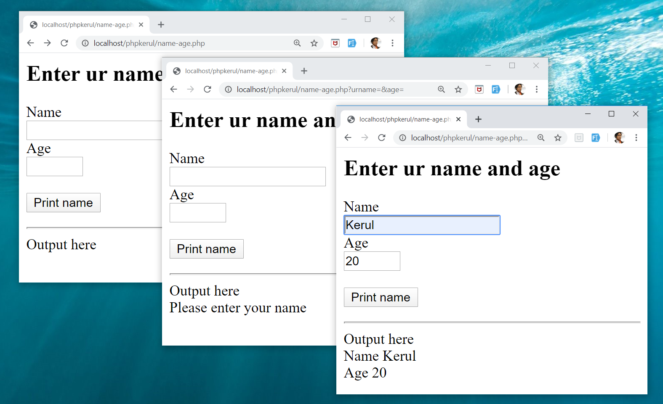
Example

Slide 92
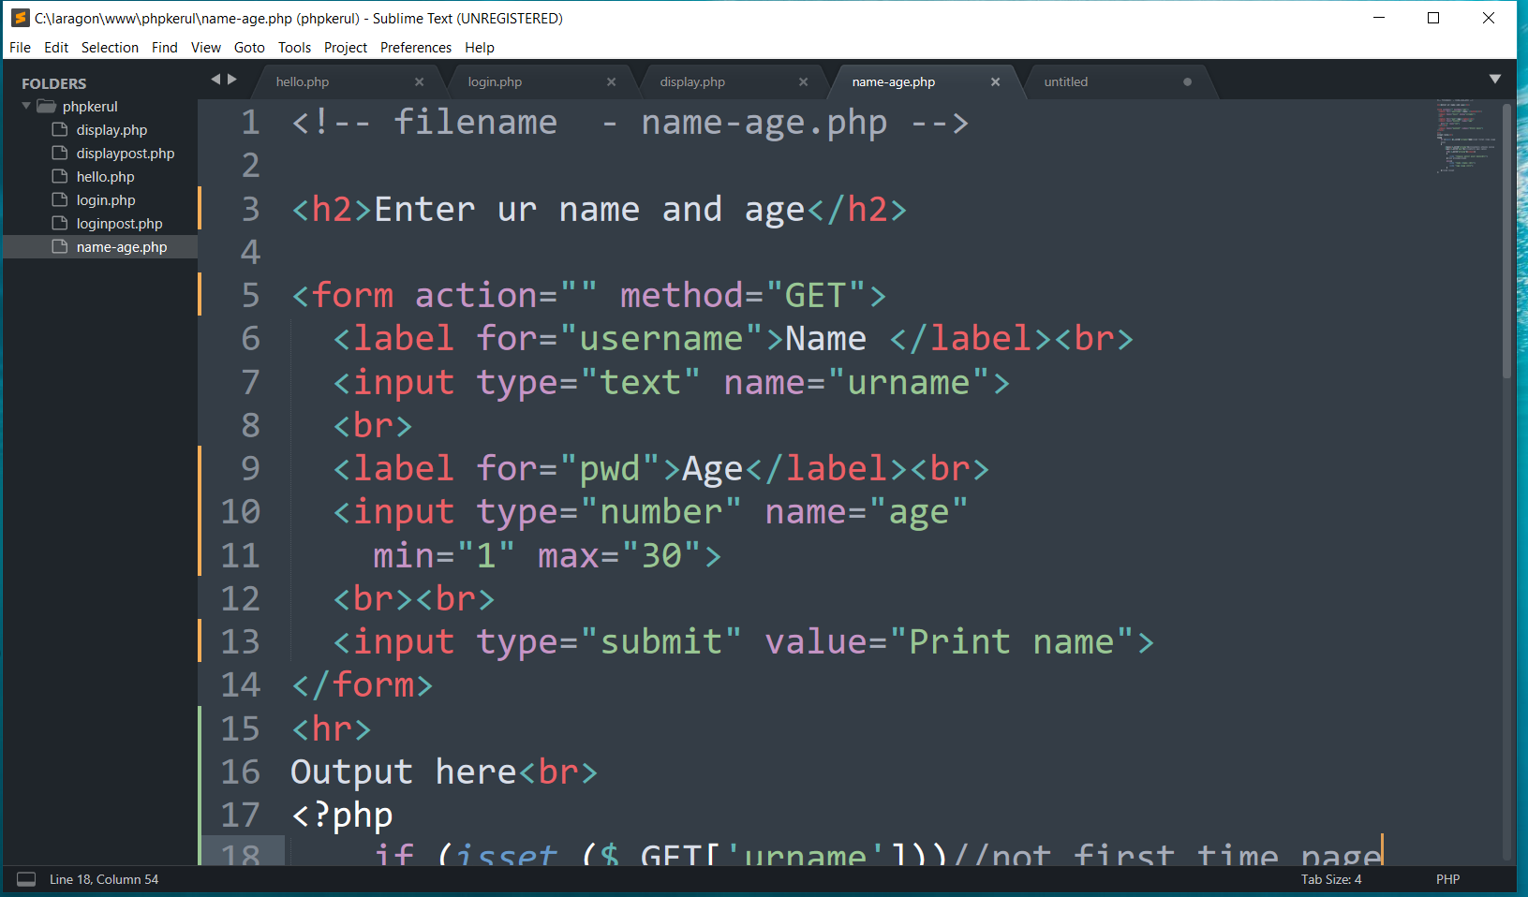
FORM (name-age.php )

Slide 93
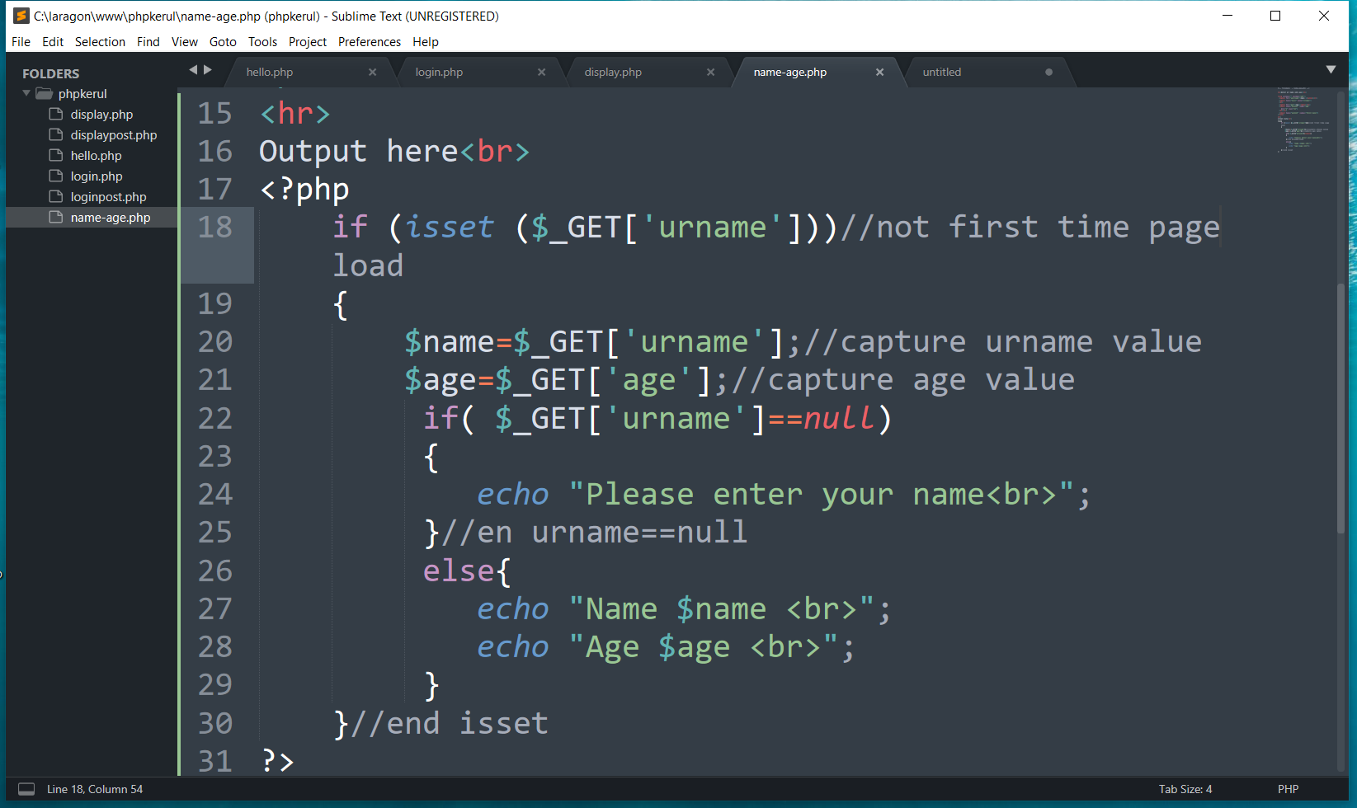
THE PHP IF…ELSE

Slide 94
T08 ITERATION (ULANGAN) FOR LOOp
w
bit.ly/fstmtube

Slide 95
Repetition in PHP
There are many ways of doing repetition. Three of them:
for
while and do…while
foreach

Slide 96
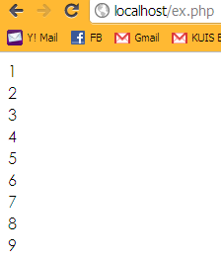
for structure
E.g.:
<?php
for ($i=1; $i<=9;$i++){
echo "$i<br>";
}
?>

Slide 97
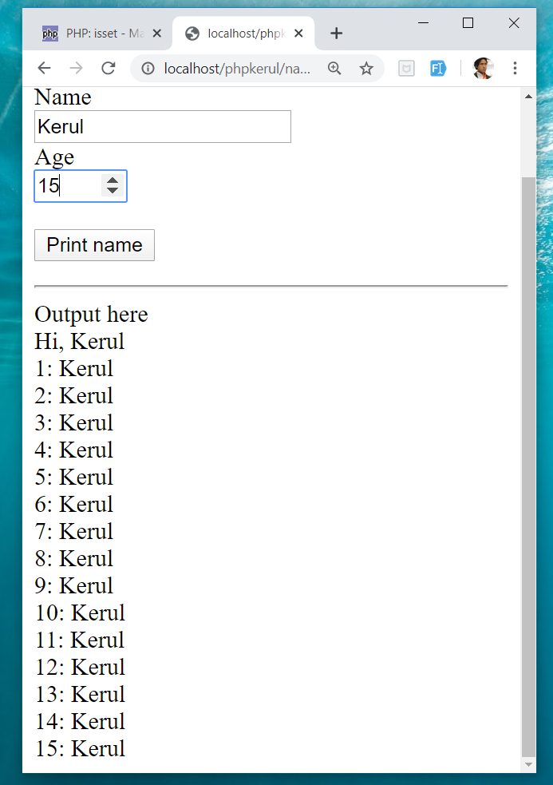
OUTPUT SAMPLE

Slide 98
T09 ARRAY (TATASUSUNAN) FOREACH
w
bit.ly/fstmtube

Slide 99
Introduction of Array
A variable is a storage area holding a number or text. The problem is a variable hold only one value.
An array is a special variable, which can store multiple values in one single variable.

Slide 100
Introduction of Array (cont)
If you have a list of items (a list of student names, for e.g.), storing the student names in single variables could look like this:
$std1="Anas"; $std2="Hajar"; $std3="Shah";

Slide 101
Introduction of Array
In PHP, there are 3 kind of arrays:
Numeric array - An array with a numeric index.
Assign using AUTOMATIC method.
Assign using MANUAL method.
Associative array - An array where each ID key is associated with a value.
Multidimensional array - An array containing one or more arrays.

Slide 102
Numeric Array
Assign using AUTOMATIC method (the index starts at 0).
$std = array("Anas", "Hajar", "Shah", "Nurul");
Assign using MANUAL method.
$std[0]="Anas"; $std[1]="Hajar"; $std[2]="Shah"; $std[3]="Nurul";

Slide 103
Example
<?php
$std[0]="Anas";
$std[1]="Hajar";
$std[2]="Shah";
$std[3]="Nurul";
echo $std[0] . " and " . $std[1] . " are students of FSTM.";
?>

Slide 104
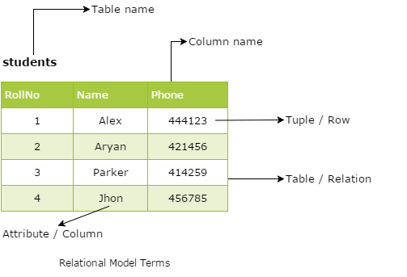
Associative Array
$record['rollno' ]=5;
$record['name']="Kerul";
$record['phone’]=90346;

Slide 105
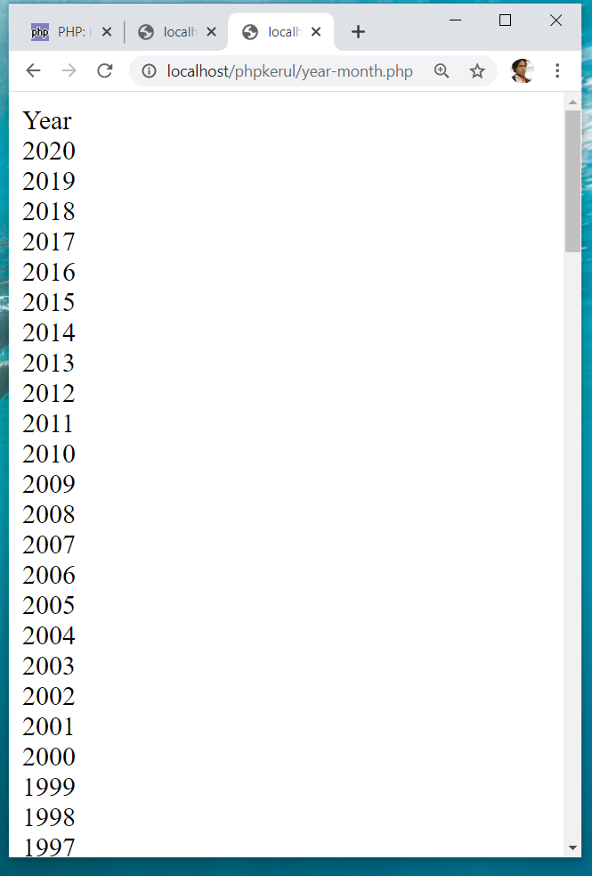
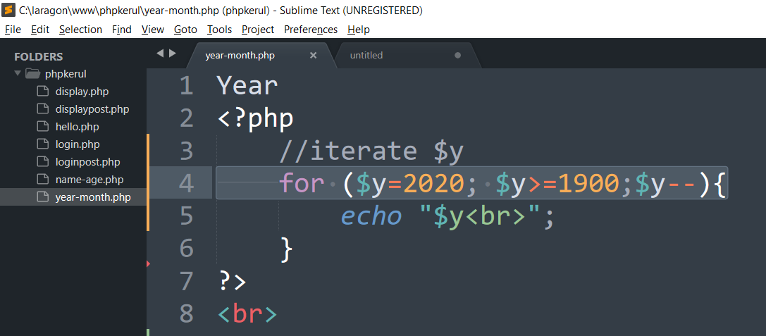
DISPLAY YEARS in DROPDOWN

Slide 106
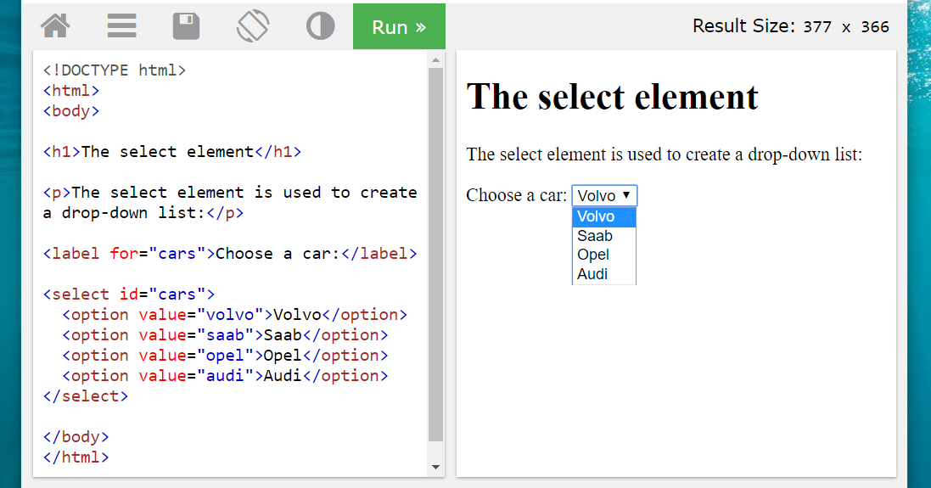
SELECT
OPTION

Slide 107
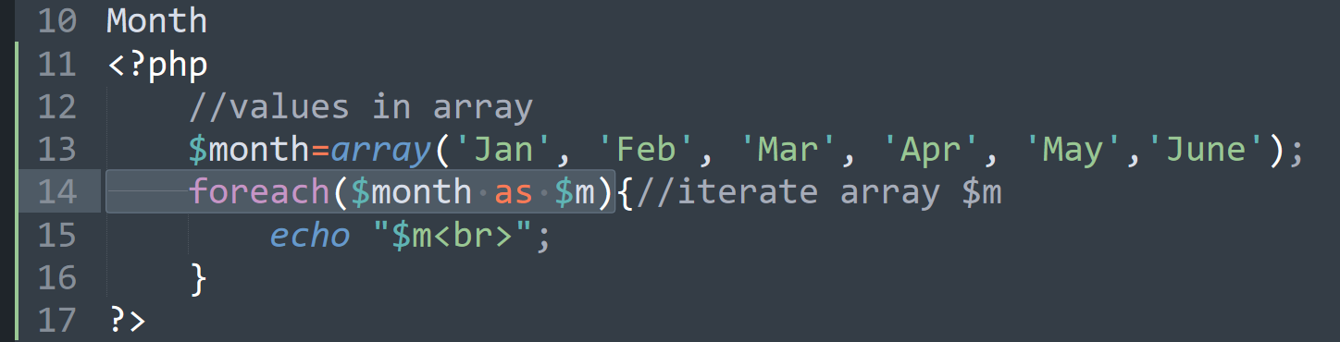
FOREACH

Slide 108
T10 FILE UPLOAD (MUAT-NAIK FAIL)
w
bit.ly/fstmtube

Slide 109
DISCLAIMER
Codes are for demo purposes. Example showed here are only to validate the proof of concepts. Security aspect the demonstrated examples are beyond the coverage of these tutorials. You are advised to explore / sought after advanced topics of PHP web programming as the issues are covered in the advanced level.

Slide 110
move_uploaded_file function
The move_uploaded_file() function moves an uploaded file to a new location.
This function returns TRUE on success, or FALSE on failure.
Syntax:
move_uploaded_file(file,newloc)
file: Specifies the file name.
newloc: Specifies the new location (destination) for the file.

Slide 111
PHP.ini
In php settings ( locate file php.ini from Laragon), turn-on the file upload
file_uploads = On

Slide 112
UPLOAD FORM (ONLY FOR IMAGE)
<!DOCTYPE html> <html> <body> <form action= "saveupload.php" method="post" enctype="multipart/form-data"> Select image to upload: <input type="file" name="fileToUpload" <input type="submit" value="Upload Image" name="submit"> </form> </body> </html>

Slide 113
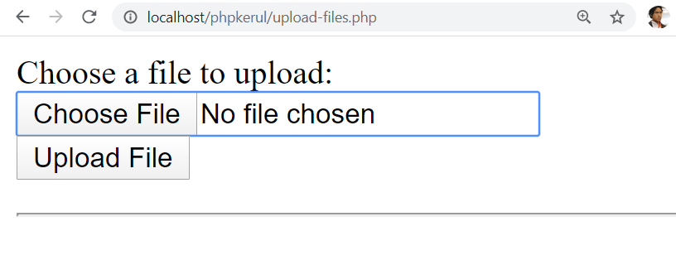
enctype
enctype="multipart/form-data" - POST request with file-upload, have to encode the data that forms the body of the request.
<input name="fileToUpload" type="file" > - the form control to choose a file and upload to server.

Slide 114
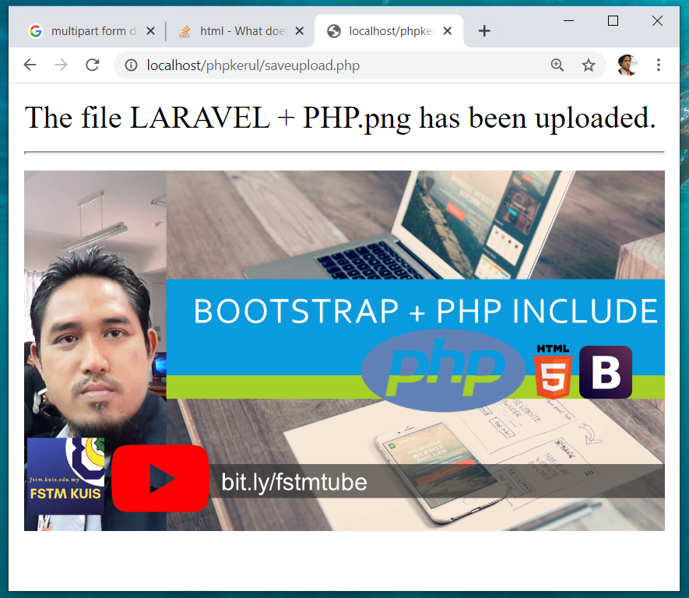
OUTPUT

Slide 115
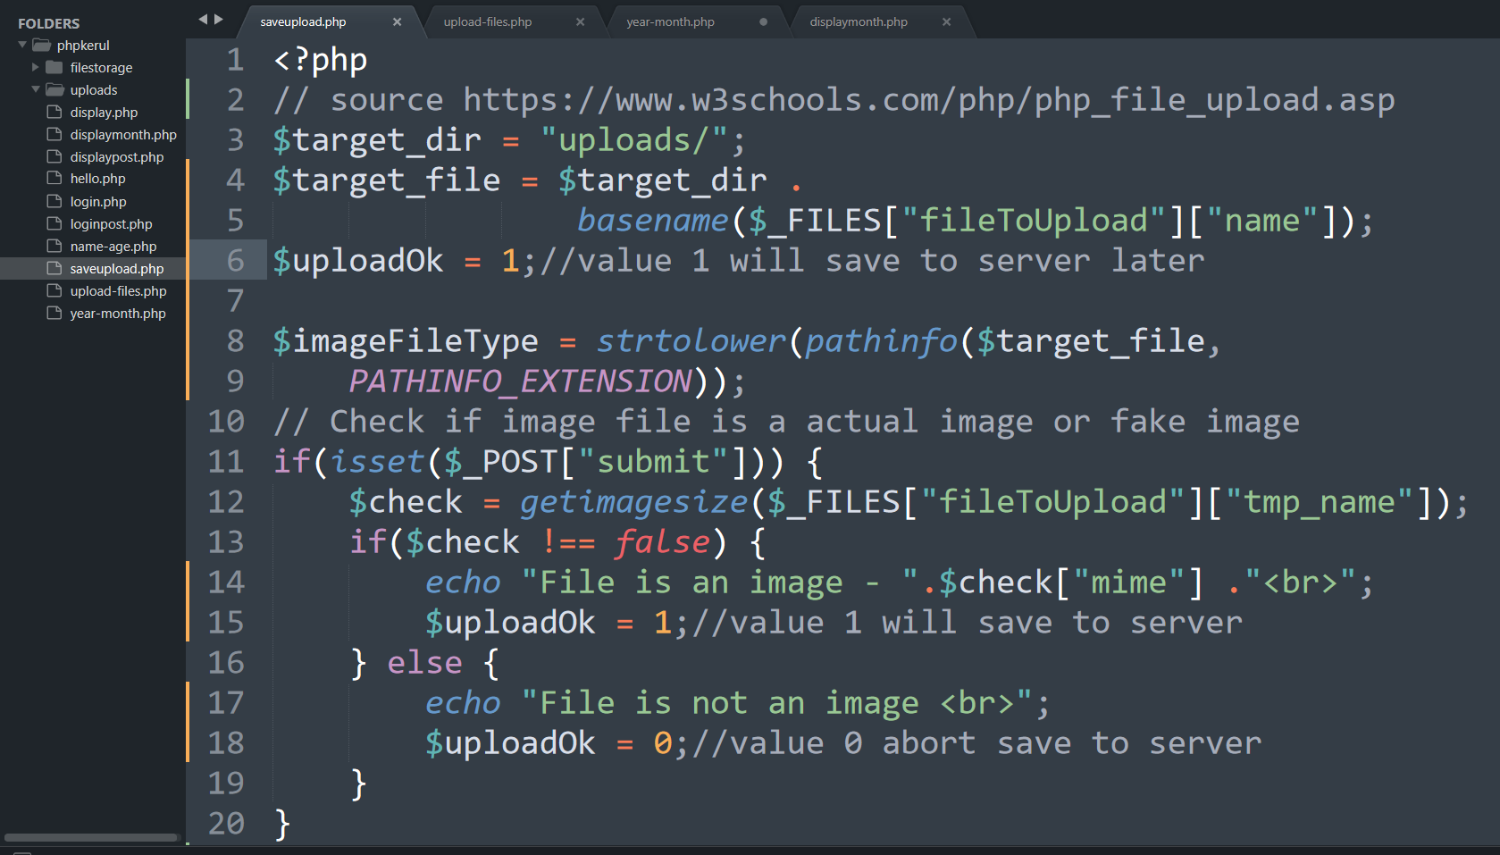
PHP to store image in server
Source: www.w3schools.com/php/php_file_upload.asp

Slide 116
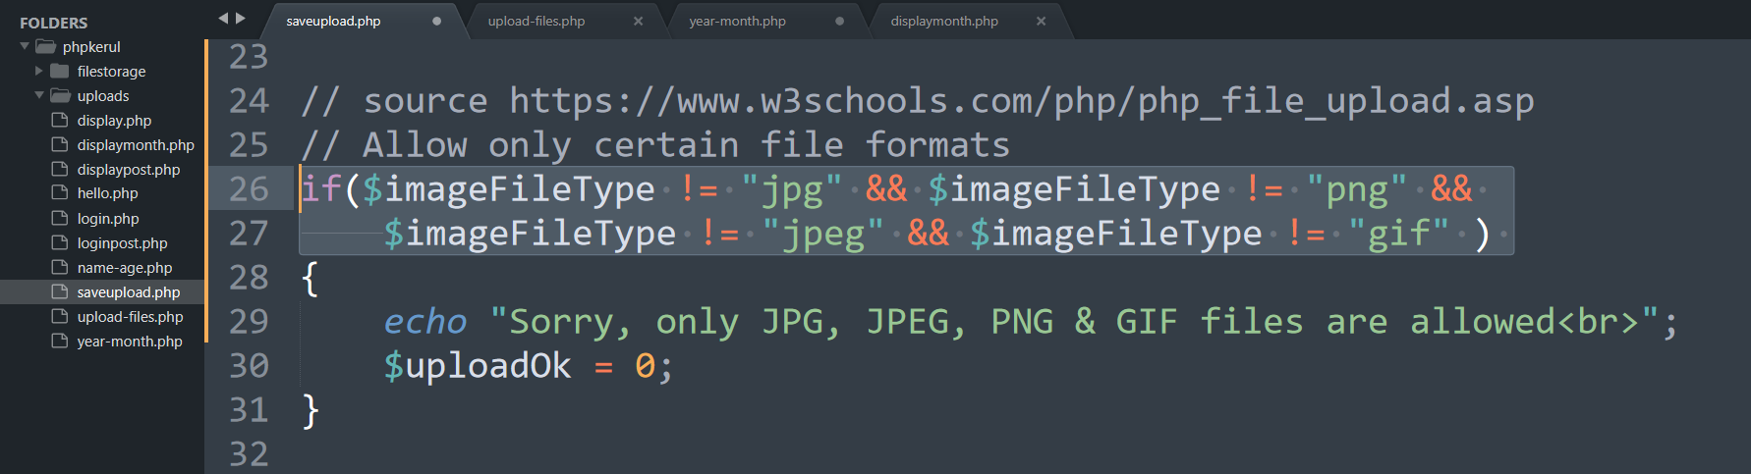
PHP to store image in server
Source: www.w3schools.com/php/php_file_upload.asp

Slide 117
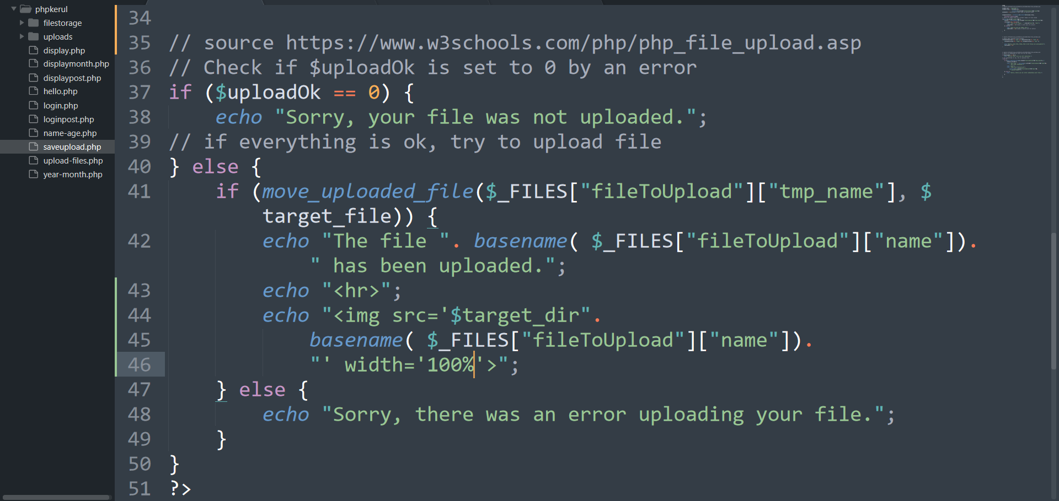
PHP to store image in server
Source: www.w3schools.com/php/php_file_upload.asp

Slide 118
OUTPUT

Slide 119

T11 php OOP (PENGATURCARAAN BERASASKAN OBJEK)
bit.ly/fstmtube

Slide 120
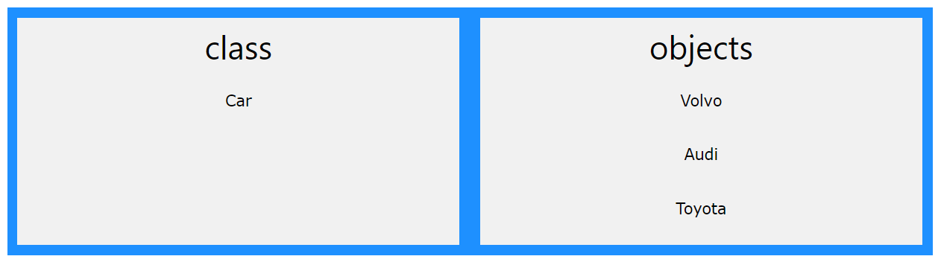

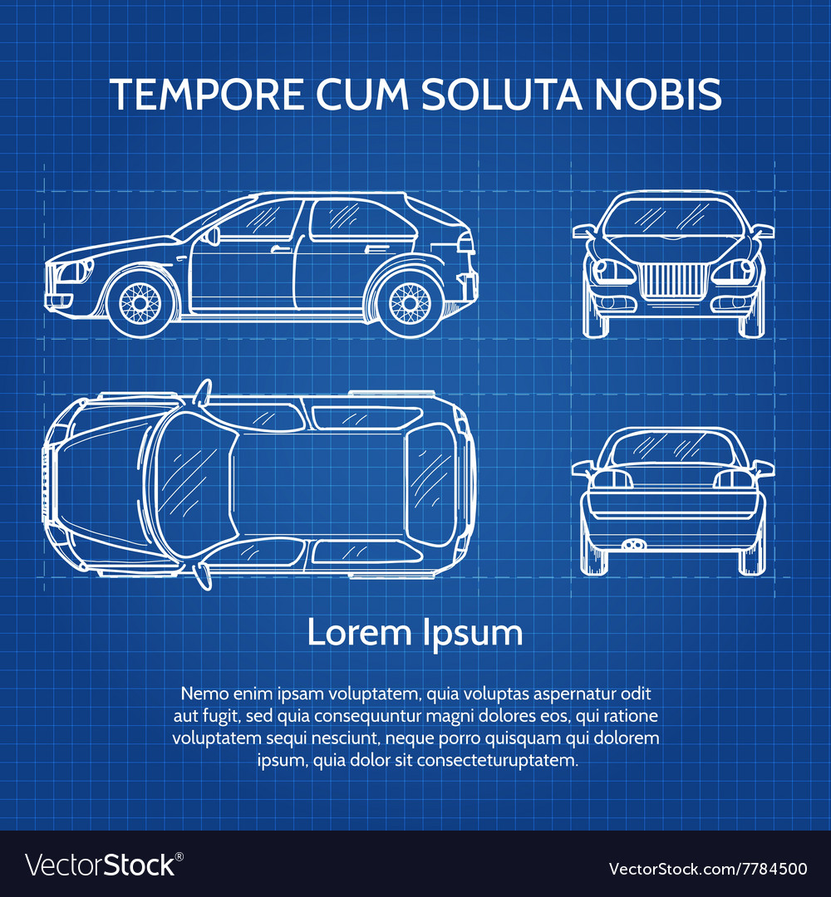

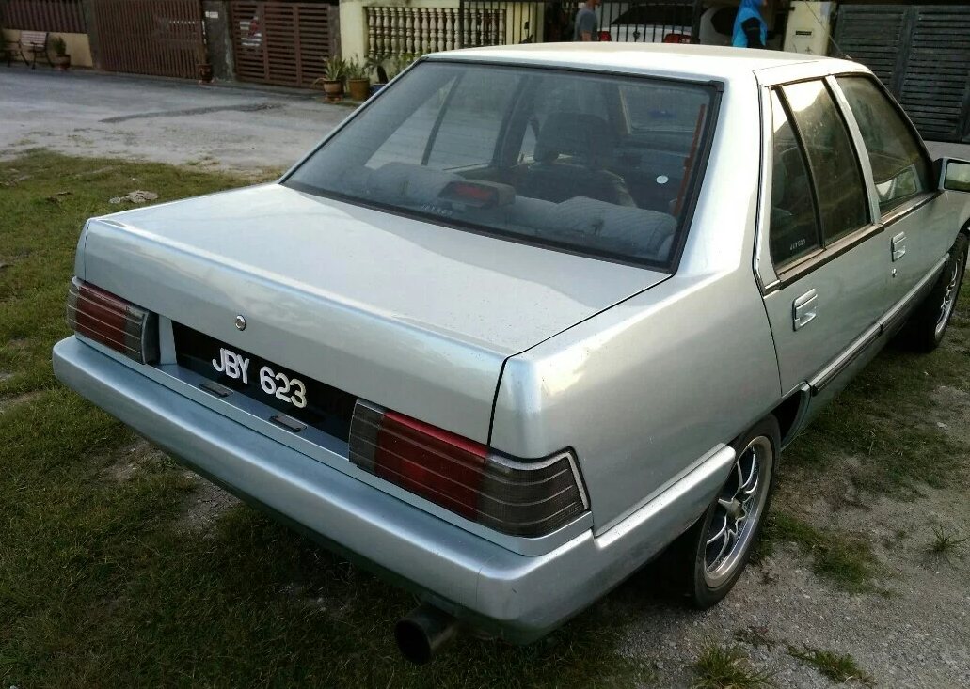
OOP
Object Oriented Programming - We can imagine our surroundings are full of objects cars, trees, houses, etc. Same way there is object oriented programming concepts which assume everything as an object and implement a software/system parts using different objects.
w3schools

Slide 121
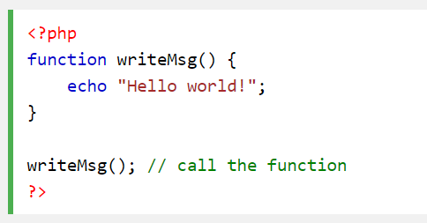
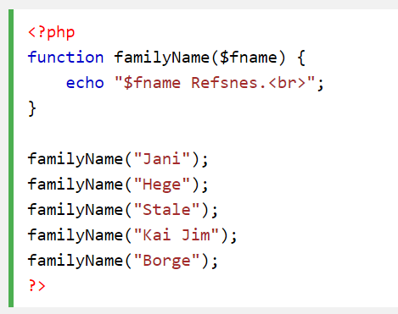
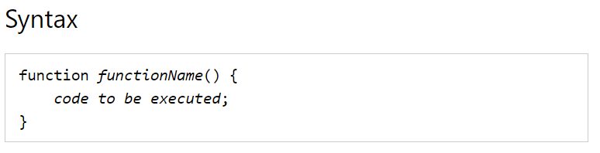
FUNCTION IN PHP
A function is a block of statements that can be used repeatedly in a program.
Without arguments.
With arguments.

Slide 122
MODULAR PHP FUNCTION
Tokenization
Post Tagging
Vocab
Outside Vocab
Annotati
Output generation
Input file

Slide 123
Class
PHP OOP
Methods
Properties
Classes and objects are the two main aspects of object-oriented programming.
Class
Method/function
Object call
Constructor
Static method/property
Inheritance

Slide 124
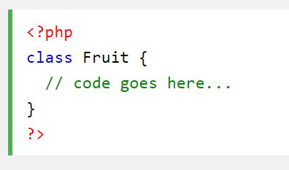
PHP Class

Slide 125

CLASS Method

Slide 126


PHP Class with Constructor

Slide 127
PHP Object Call

Slide 128


STATIC METHOD/PROPERTIES
w3schools

Slide 129

INHERITANCE
Inheritance in OOP = When a class derives from another class.
The child class will inherit all the public and protected properties and methods from the parent class. In addition, it can have its own properties and methods.
An inherited class is defined by using the extends keyword.
Parent /
Superclass
Child/Subclass

Slide 130

EXAMPLE ON INHERITANCE

Slide 131

INHERITANCE: PHP FRAMEWORK
bit.ly/fstmtubelaravel

Slide 132

T12 PREPARING MYSQL DATABASE SERVER (PANGKALAN DATA)
bit.ly/fstmtubephpmysql

Slide 133

T12 PREPARING MYSQL DATABASE SERVER (PANGKALAN DATA)
bit.ly/fstmtubephpmysql

Slide 134
DISCLAIMER
Codes are for demo purposes. Example showed here are only to validate the proof of concepts. Security aspect the demonstrated examples are beyond the coverage of these tutorials. You are advised to explore / sought after advanced/security topics of PHP web programming as these tutorials only for beginner level.

Slide 135

CONNECT TO MYSQL DATABASE
mysqli/PDO
E-book PHP&Mysqli get it from
khirulnizam@gmail.com or
http://fb.com/khirulnizam or
Instagram @kerul_net
These vids tutorial will cover mysqli/PDO

Slide 136

CHANGE DBSERVER ROOT PASSWORD

Slide 137

ENTER PASSWORD

Slide 138


START ALL

Slide 139


CREATE NEW DB

Slide 140

HEIDI SQL (MYSQL CILENT)

Slide 141

CREATE NEW TABLE
Right-click on dbname

Slide 142

TABLE STRUCTURE : STUDENTS
Table name: students
set auto_increment for field id

Slide 143

POPULATE DUMMY DATA
Right-click to insert new row

Slide 144
T13 DBCONNECT PDO (PANGKALAN DATA PDO)
bit.ly/fstmtubephpmysql

Slide 145
T13 DBCONNECT PDO (PANGKALAN DATA PDO)
bit.ly/fstmtubephpmysql

Slide 146
DISCLAIMER
Codes are for demo purposes. Example showed here are only to validate the proof of concepts. Security aspect the demonstrated examples are beyond the coverage of these tutorials. You are advised to explore / sought after advanced/security topics of PHP web programming as these tutorials only for beginner level.

Slide 147
CONNECT TO MYSQL DATABASE
mysqli/PDO
E-book PHP&Mysqli get it from
khirulnizam@gmail.com or
http://fb.com/khirulnizam or
Instagram @kerul_net
These vids tutorial will cover mysqli/PDO

Slide 148

WHY PDO ?
PDO – PHP Data Object
Support different database
mysqli – only for MySQL
database connection
https://www.php.net/manual/en/book.pdo.php

Slide 149

TEST DBCONNECT TO DATABASE

Slide 150

HOW TO DISPLAY ALL RECORDS

Slide 151

EMBED SQL STATEMENT

Slide 152

SUBSCRIBE FSTM KUIS CHANNEL

Slide 153
T14 DBCONNECT using mysqli (Pangkalan Data mysqli)
bit.ly/fstmtubephpmysql

Slide 154
STAY HOME5, SAVE MALAYSIA! t14: mysqli
bit.ly/fstmphpmysqli

Slide 155
DISCLAIMER
Codes are for demo purposes. Example showed here are only to validate the proof of concepts. Security aspect the demonstrated examples are beyond the coverage of these tutorials. You are advised to explore / sought after advanced/security topics of PHP web programming as these tutorials only for beginner level.
Suitable to view in DESKTOP

Slide 156
CONNECT TO MYSQL DATABASE
mysqli
E-book PHP&Mysqli get it from
khirulnizam@gmail.com or
http://fb.com/khirulnizam or
Instagram @kerul_net
These vids tutorial will cover mysqli

Slide 157
3-tier – DATABASE CONNECTION
Tier3 : Database
Tier1 : Client/browser
Tier2 : Middleware (Webserver + PHP)

Slide 158

CREATE NEW DB

Slide 159

PREPARE DATABASE NAME & TABLE

Slide 160
mysqli_connect ( )
<?php
$servername = "localhost";//server location / IP number
$username = "root";//db admin username
$password = "abcd1234";//password for db admin username
$dbname = "newsystem";//database name
// Create connection
$conn = mysqli_connect($servername, $username,
$password, $dbname);

Slide 161

mysqli_connect ( )

Slide 162

TEST SQL COMMANDS

Slide 163
MSQLI FUNCTIONS
$result = mysqli_query($conn, $sql)
PHP.net/mysqli_query : Performs an SQL query on the database
if (mysqli_num_rows($result) > 0)
PHP.net/mysqli_num_rows : Gets the number of rows in a result
while($row = mysqli_fetch_assoc($result)) {
PHP.net/mysqli_fetch_assoc : Fetch a result row as an associative array

Slide 164
Associative Array
$record['rollno']=5;
$record['name']="Kerul";
$record['phone’]=90346;

Slide 165

EMBED SQL IN PHP

Slide 166

DISPLAY RESULT SET

Slide 167
SUBSCRIBE FSTM KUIS CHANNEL

Slide 168
T15 SEARCH IN DB (Carian dalam DB)
bit.ly/fstmtubephpmysql

Slide 169
DISCLAIMER
Codes are for demo purposes. Example showed here are only to validate the proof of concepts. Security aspect the demonstrated examples are beyond the coverage of these video tutorials. You are advised to explore / sought after advanced/security topics of PHP web programming as these tutorials only for beginner level.
Suitable to view in DESKTOP

Slide 170
CONNECT TO MYSQL DATABASE
mysqli
E-book PHP&Mysqli get it from
khirulnizam@gmail.com or
http://fb.com/khirulnizam or
Instagram @kerul_net
Video tutorial will cover mysqli

Slide 171


Code & Slides github.com/khirulnizam/ newsystem

Slide 172

CODE: search.php

Slide 173

POPULATE DATA INSIDE TABLE

Slide 174
Next

Slide 175

T16 BOOTSTRAP TEMPLATE
bit.ly/fstmtphpmysqli

Slide 176
EXAMPLE OF IMPLEMENTATION

Slide 177
GITHUB
https://github.com/khirulnizam/newsystem

Slide 178
DISCLAIMER
Codes are for demo purposes. Example showed here are only to validate the proof of concepts. Security aspect the demonstrated examples are beyond the coverage of these video tutorials. You are advised to explore / sought after advanced/security topics of PHP web programming as these tutorials only for beginner level.
Suitable to view in DESKTOP

Slide 179
CONNECT TO MYSQL DATABASE
mysqli
E-book PHP&Mysqli get it from
khirulnizam@gmail.com or
http://fb.com/khirulnizam or
Instagram @kerul_net
Video tutorial will cover mysqli

Slide 180
Include php
include ("header.php");
<our content>
include ("footer.php");

Slide 181
startbootstrap.com/themes/sb-admin-2/

Slide 182
EXAMPLE OF IMPLEMENTATION

Slide 183

T17 INSERT RECORD (MASUKKAN REKOD BAHARU)
bit.ly/fstmtphpmysqli

Slide 184
EXAMPLE OF IMPLEMENTATION

Slide 185
GITHUB
https://github.com/khirulnizam/newsystem

Slide 186
DISCLAIMER
Codes are for demo purposes. Example showed here are only to validate the proof of concepts. Security aspect the demonstrated examples are beyond the coverage of these video tutorials. You are advised to explore / sought after advanced/security topics of PHP web programming as these tutorials only for beginner level.
Suitable to view in DESKTOP

Slide 187
CONNECT TO MYSQL DATABASE
mysqli
E-book PHP&Mysqli get it from
khirulnizam@gmail.com or
http://fb.com/khirulnizam or
Instagram @kerul_net
Video tutorial will cover mysqli

Slide 188
OVERVIEW

Slide 189

forminsert.php

Slide 190

forminsert.php

Slide 191

forminsert.php

Slide 192

INSERT INTO

Slide 193

T18 SHOW DETAILS (Paparan semua data rekod)
bit.ly/fstmphpbootstrap

Slide 194

OVERVIEW

Slide 195
DISCLAIMER
Codes are for demo purposes. Example showed here are only to validate the proof of concepts. Security aspect the demonstrated examples are beyond the coverage of these video tutorials. You are advised to explore / sought after advanced/security topics of PHP web programming as these tutorials only for beginner level.
Suitable to view in DESKTOP

Slide 196
CONNECT TO MYSQL DATABASE
mysqli
E-book PHP&Mysqli get it from
khirulnizam@gmail.com or
http://fb.com/khirulnizam or
Instagram @kerul_net
Video tutorial will cover mysqli

Slide 197
Code & Slides github.com/khirulnizam/ newsystem

Slide 198
OVERVIEW

Slide 199
search-admin.php

Slide 200


Slide 201
formshow.php

Slide 202


Slide 203


Slide 204


Slide 205
Code & Slides github.com/khirulnizam/ newsystem

Slide 206

T19 UPDATE RECORD (Kemaskini data rekod)
bit.ly/fstmphpbootstrap

Slide 207

UPDATE RECORD PROCESS
search-admin.php
id
id

Slide 208
OVERVIEW
Cancel
Save Record

Slide 209
DISCLAIMER
Codes are for demo purposes. Example showed here are only to validate the proof of concepts. Security aspect the demonstrated examples are beyond the coverage of these video tutorials. You are advised to explore / sought after advanced/security topics of PHP web programming as these tutorials only for beginner level.
Suitable to view in DESKTOP

Slide 210
CONNECT TO MYSQL DATABASE
mysqli
E-book PHP&Mysqli get it from
khirulnizam@gmail.com or
http://fb.com/khirulnizam or
Instagram @kerul_net
Video tutorial will cover mysqli

Slide 211
Code & Slides github.com/khirulnizam/ newsystem

Slide 212

UPDATE COMMAND SQL

Slide 213

T20 DELETE RECORD (Padam rekod)
bit.ly/fstmphpbootstrap

Slide 214

UPDATE RECORD PROCESS
search-admin.php
id
confirmdelete( )
id

Slide 215
OVERVIEW
Save Record

Slide 216
DISCLAIMER
Codes are for demo purposes. Example showed here are only to validate the proof of concepts. Security aspect the demonstrated examples are beyond the coverage of these video tutorials. You are advised to explore / sought after advanced/security topics of PHP web programming as these tutorials only for beginner level.
Suitable to view in DESKTOP

Slide 217
CONNECT TO MYSQL DATABASE
mysqli
E-book PHP&Mysqli get it from
khirulnizam@gmail.com or
http://fb.com/khirulnizam or
Instagram @kerul_net
Video tutorial will cover mysqli

Slide 218
Code & Slides github.com/khirulnizam/ newsystem

Slide 219

UPDATE COMMAND SQL

Slide 220
T21 INNER JOIN (Gabungan dua jadual)

Slide 221


1-Many relationship

Slide 222
DISCLAIMER
Codes are for demo purposes. Example showed here are only to validate the proof of concepts. Security aspect the demonstrated examples are beyond the coverage of these video tutorials. You are advised to explore / sought after advanced/security topics of PHP web programming as these tutorials only for beginner level.
Suitable to view in DESKTOP

Slide 223
CONNECT TO MYSQL DATABASE
mysqli
E-book PHP&Mysqli get it from
khirulnizam@gmail.com or
http://fb.com/khirulnizam or
Instagram @kerul_net
Video tutorial will cover mysqli

Slide 224
Code & Slides github.com/khirulnizam/ newsystem

Slide 225

DISPLAY OPTIONS FROM TABLE TO DROP-DOWN

Slide 226

OUTPUT

Slide 227
T22 INNER JOIN DISPLAY (Papar gabungan dua jadual)

Slide 229
1-Many relationship

Slide 230
DISCLAIMER
Codes are for demo purposes. Example showed here are only to validate the proof of concepts. Security aspect the demonstrated examples are beyond the coverage of these video tutorials. You are advised to explore / sought after advanced/security topics of PHP web programming as these tutorials only for beginner level.
Suitable to view in DESKTOP

Slide 231
CONNECT TO MYSQL DATABASE
mysqli
E-book PHP&Mysqli get it from
khirulnizam@gmail.com or
http://fb.com/khirulnizam or
Instagram @kerul_net
Video tutorial will cover mysqli

Slide 232
1-Many relationship

Slide 233

SQL: INNER JOIN

Slide 234

OUTPUT

Slide 235


MOBIRISE
Mobirise – a free web design studio that support HTML5 & Bootstrap’s famous ‘block’ design.

Slide 236

MOBIRISE
Done with the talking, lets walk the talk… ;)

Slide 237

Select theme

Slide 238

Start here

Slide 239

Select block

Slide 240


Slide 242

MOBIRES- CHANGING IMAGE

Slide 243

MOBIRES- TEXT EDITING

Slide 244


Slide 245


Slide 246

Thank you very much
Newton keep asking, Why apple FALL from tree?
Everybody asks silly questions before becoming a star…

